Slide 1
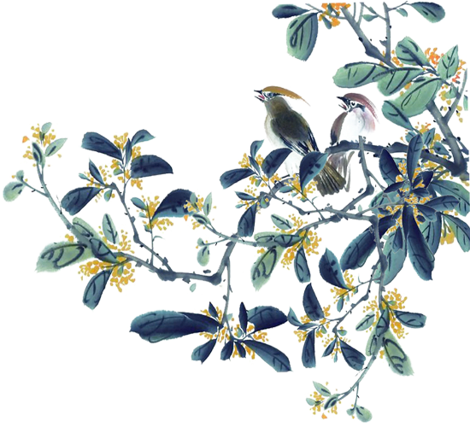



Science
75 Min
DIY Jiànzi
Kick, Spin, Soar!
Notes:
Welcome learners warmly and introduce the session. Begin with energy! Say: "Today, you're going to learn, build, and PLAY!" Set the tone for active discovery.

Slide 2
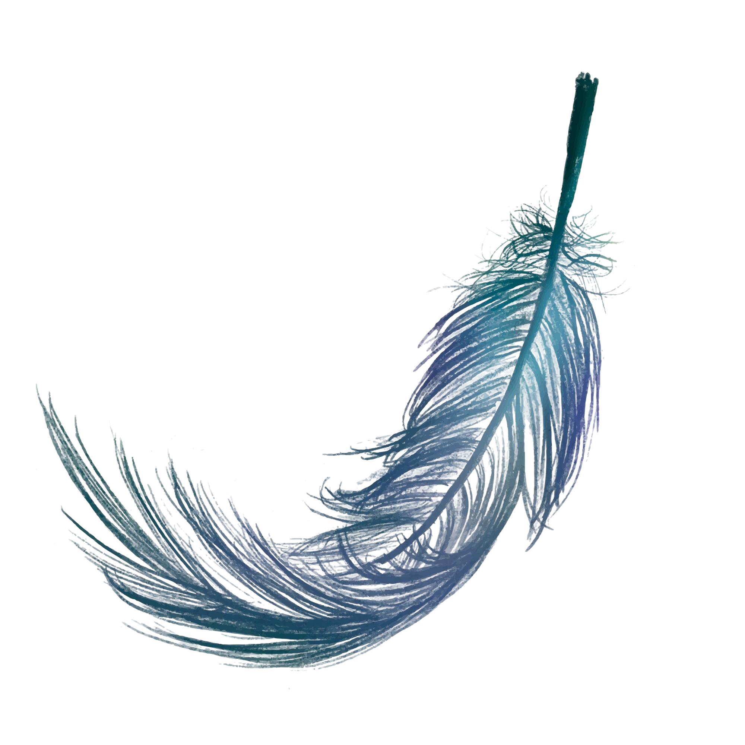
Look!
Look closely at this object.
Can you guess how people in different parts of the world might have used it?
Notes:
Invite learners to quietly observe the image.
Ask: “What do you think this is? What could it be used for?”
Encourage many interpretations. Celebrate unusual ideas.

Slide 3
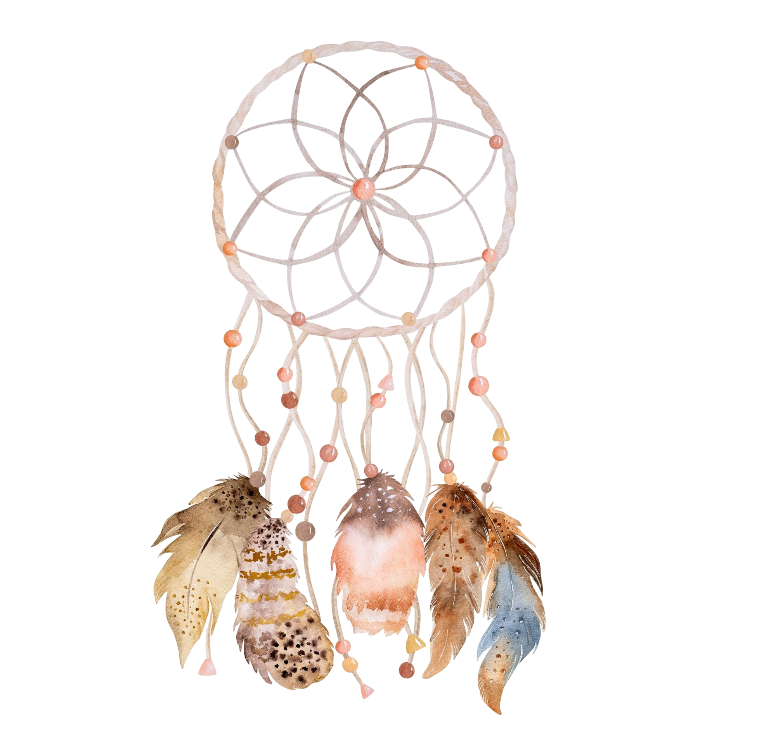
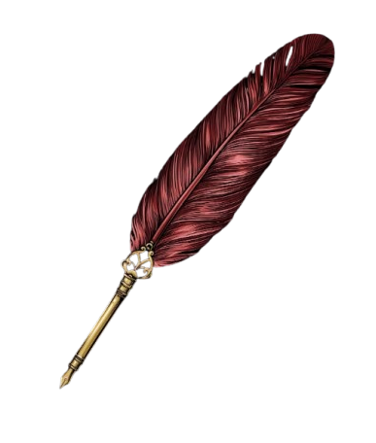
Feather in Different Cultures
Feathers do more than help birds fly! People have used them in various ways, such as decorating clothes, making tools, and celebrating in ceremonies.
Native American people use feathers in headdresses and dreamcatchers. The feathers stand for honor, protection, and nature.
In medieval Europe, people didn’t have pens like we do today. They dipped feather quills in ink to write stories, letters, and history.
Notes:
Read or paraphrase examples. Ask: “Why do you think feathers are special?”
Invite learners to share examples from their culture or celebrations. Connect to art, history, festivals, traditions.

Slide 4
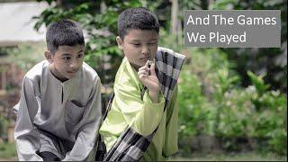
Jiànzi: The Feather Toy
See how feathers and weight work together to create a toy that flies!
Notes:
Play the video. Before it starts, ask students to look for how the feathers move. After watching: “Why do you think it spins?” “Does spinning help it fly?”
Ask: “Have they ever played with this or something similar?” Encourage many interpretations. Celebrate unusual ideas.

Slide 5
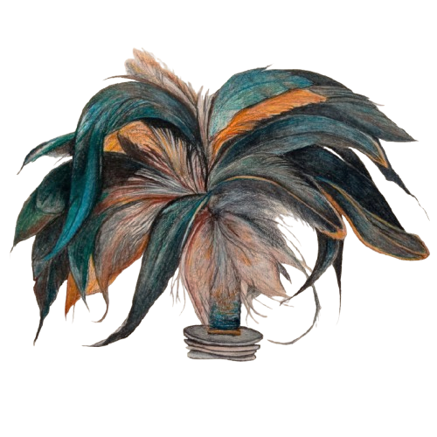
Session Objectives
1
Explore how Jiànzi is played across cultures.
2
Identify how weight and design affect a Jiànzi’s flight.
3
Design and build your own Jiànzi.
Test your Jiànzi and refine it for better flight.
4
Notes:
Read each objective aloud. Ask, “Which one are you most excited about?”
Relate each objective to the final task (playing a game).

Slide 6
A Game with History
Regional Names: Chapteh, Da Cau, Sipa, Jeigichagi
Featured at the 1936 Berlin Olympics
2000 Years Ago: Training Tool for Chinese Soldiers
Still Popular in Parks, Schools, and Championships
Notes:
Introduce learners to the cultural and historical significance of Jianzi, highlighting its ancient origins, regional variations, and continued relevance today.
Jiànzi dates back over 2,000 years, once used by Chinese soldiers for training.
It is known as Da Cau in Vietnam, Sipa in the Philippines, Jeigichagi in Korea, and Chapteh in Singapore/Malaysia.
It featured at the 1936 Berlin Olympics, where Chinese athletes showcased it.
It is still popular today—from parks and schools to international championships.

Slide 7

Jiànzi in Action
Jiànzi is played by kicking it to keep it in the air. The feathers help it spin and glide, like a bird or shuttlecock.
You can play alone or with friends.
It’s a toy that mixes culture, movement, and science.
Fun Fact
While playing Jiànzi you can use any body part except your hands to keep the shuttlecock in the air—feet, knees, chest, even your head.
Notes:
Use a real Jiànzi if you have one. Pass it around. Ask: “What does this remind you of?” “Why do you think feathers are on it?” Link it to shuttlecocks or bird flight if students mention them. Help learners understand the basic mechanics of playing Jiànzi, while appreciating the blend of cultural significance, movement, and simple physics behind the toy.

Slide 8
Your Task
Create your own Jiànzi using feathers, threads, washers, etc.
Criteria 1
Secure Attachment
Feathers are firmly attached and arranged to help the Jiànzi spin well.
Criteria 2
Balanced Weight
The weighted base is stable and balanced to keep the Jiànzi flying smoothly.
See worksheet pg. 1 to know more about your task.
Notes:
Go over the success criteria clearly: Feathers attached firmly and balanced weight. Emphasize: "There’s no perfect way—try, test, and tweak!" Encourage creativity in decoration too.

Slide 9

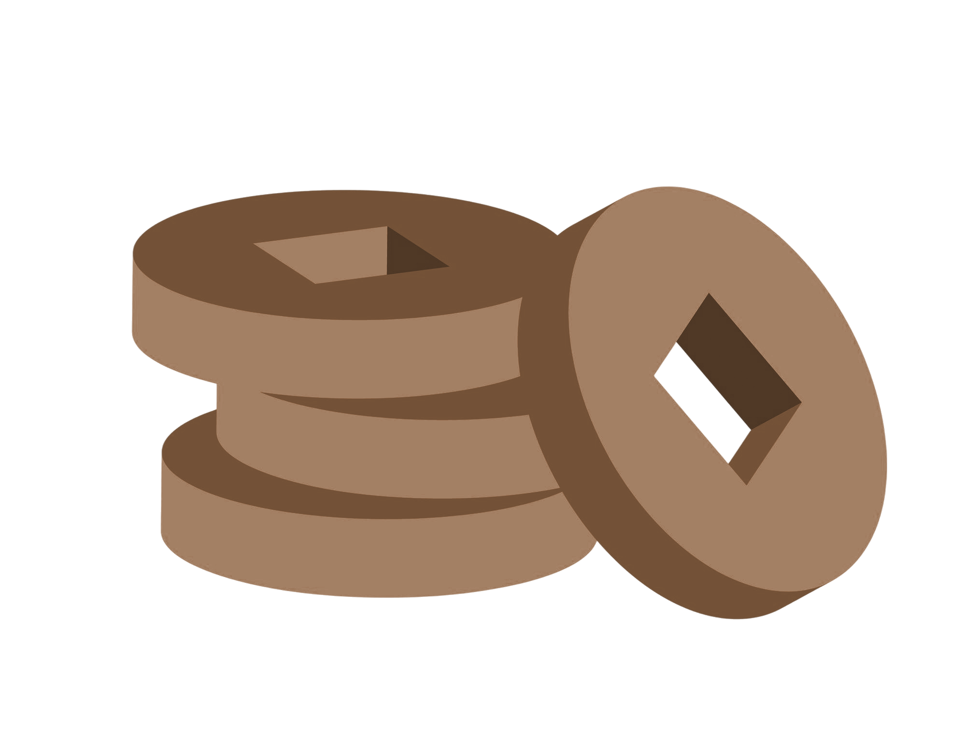

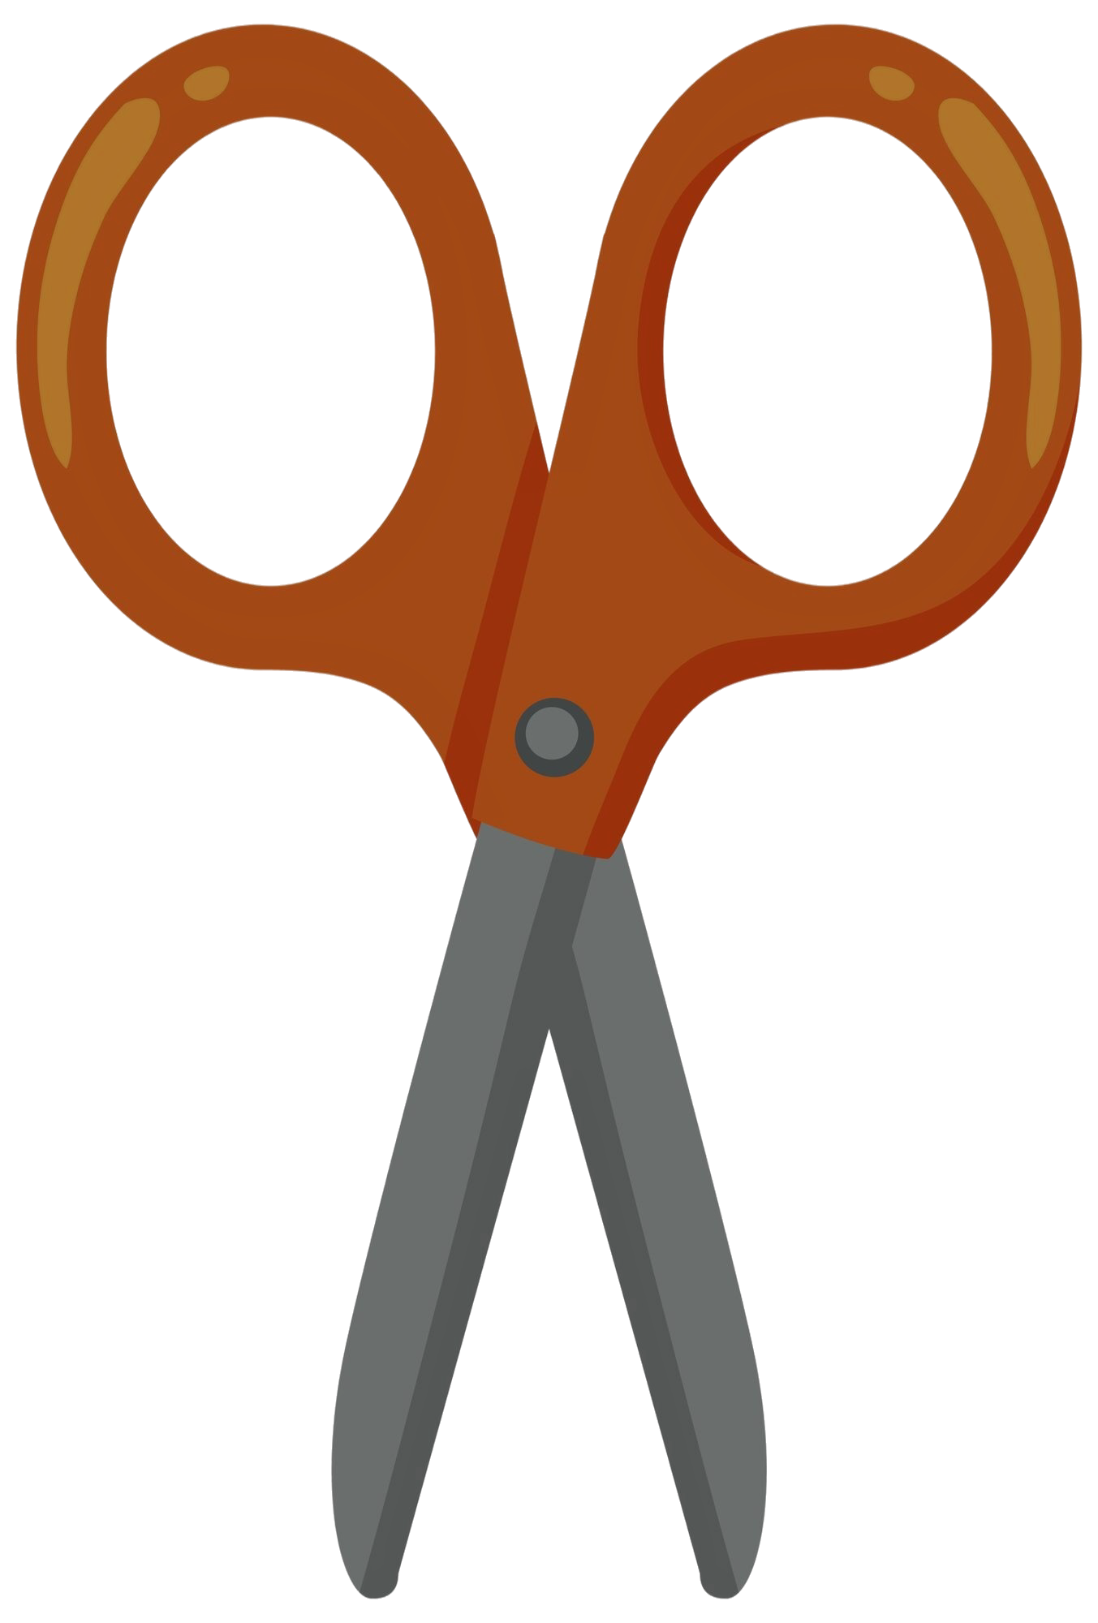
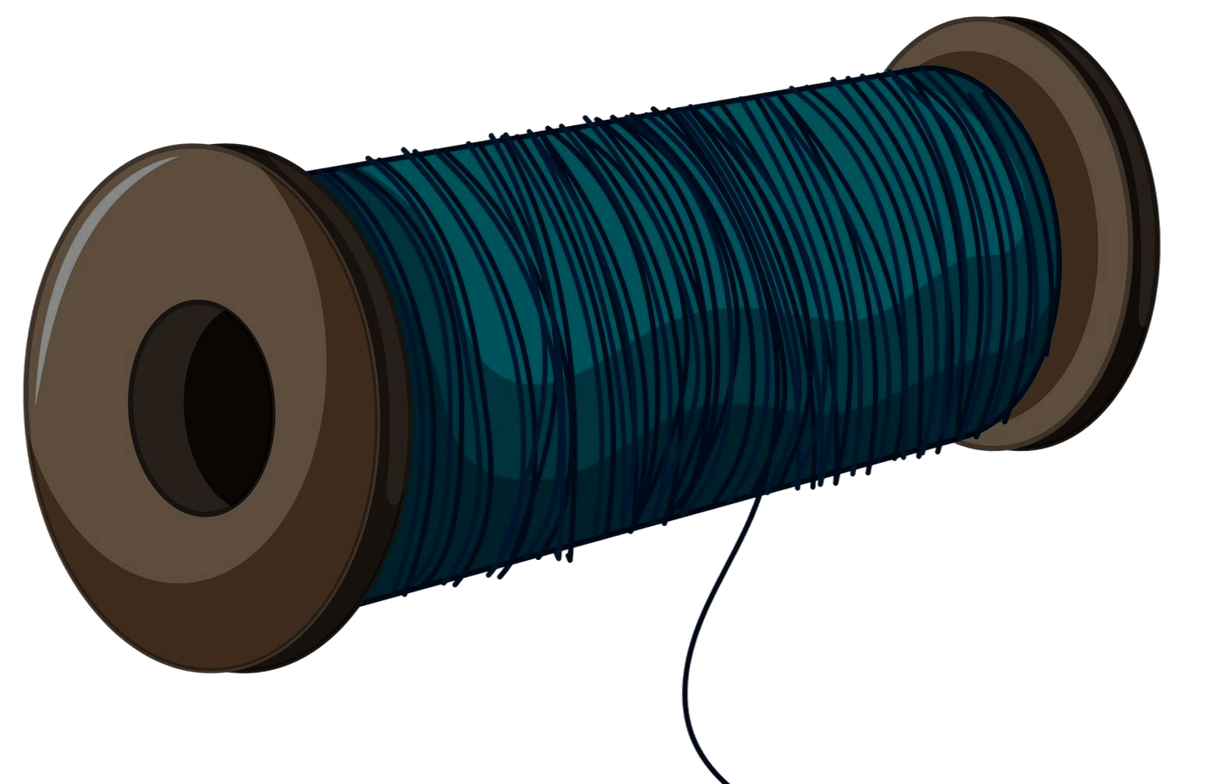


Meet the Material
Feathers Thread Leather Strip Plastic Tube Coins Leather Pad Scissors
What are the parts of a Jiànzi?
What is the purpose of each part?
What seems complex about how it all works together?
Notes:
Lay materials out visibly. Let students touch and explore them. Ask: “What material do you think is most important for flying?” Why? Let them add/substitute or add other materials if available. Use the Part-Purpose-Complexities thinking routine for further exploration.

Slide 10
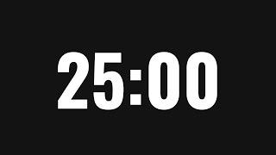
Build the Jiànzi
Follow the steps on worksheet pg. 2-4 and start building your own Jiànzi.
Notes:
Demo each step or use a visual reference (e.g. sample/model).
Walk around and help troubleshoot.
Offer quick challenges like: “Can you make one that spins extra fast?”

Slide 11
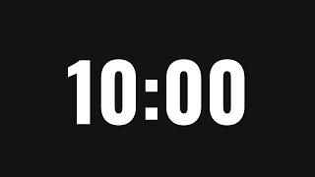
Test/Practice Time
Find a space to play with your Jiànzi.
Observe how its weight and design affect how it flies.
Make changes if needed to improve it.
Complete the activity on worksheet pg. 4-5 to improve the design of your Jiànzi.
Notes:
Encourage each learner to try multiple kicks.
Ask them to notice how it flies. Prompt: “Does it flip? Spin? Fall fast?”
Invite them to tweak designs — less tape, different feather angle, etc.
Connect to worksheet page for tips.

Slide 12

Let’s Play
Team up with a partner and play 3 rounds of Jiànzi.
Pick one challenge:
– Keep the Jiànzi in the air as long as you can.
– Count how many kicks you can do in 30 seconds.
Take turns, track each other’s scores, and cheer each other on!
Notes:
Announce it like a mini tournament. Let them self-choose challenges.
Prompt positive peer feedback: “Try cheering your partner after each round!”

Slide 13
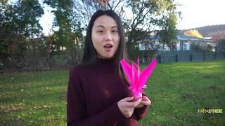

some Playing Tips
See worksheet pg. 5 to know more about these tips and common mistakes.
Notes:
Let learners watch the video and observe the key tips. Share a few simple tips like:
"Use your toe, not your heel!"
"Start with small kicks."
Let learners add their own “pro tips” to share with peers.

Slide 14
Jiànzi Challenge
Get ready to test your skills and have some fun. Let’s see who can keep their Jiànzi in the air the longest!
Notes:
Build excitement like a real contest: “Ready? 3, 2, 1... GO!”
Time the rounds. Celebrate effort and improvement, not just scores.

Slide 15
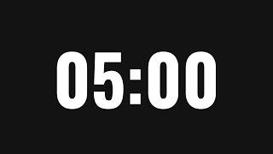
3-2-1 Reflection
3 Things I Noticed while Playing Jiànzi
2 Things I Got Better at Today
1 Question I still have about Jiànzi
Use worksheet pg. 5-6 to share your reflection.
Notes:
Give 3-5 minutes of quiet time to reflect. Option to pair-share answers after writing. Prompt questions if they’re stuck:
“What did you learn about how feathers help?”
“What was tricky about the design?”

Slide 16
Congratulations
https://www.freeppt7.com
Notes:
Celebrate the learning, the building, and the playing.
Optional: Give “Jiànzi Champion,” “Creative Builder,” or “Feather Wizard” shoutouts.
Invite students to take their chapteh home and teach someone else.

Slide 17
Additional Resources
This article traces Jiànzi’s cultural roots, its modern variations, and its growing popularity beyond China.
This video features high-level players in Singapore showcasing expert-grade Jiànzi kicking.
This link gives detailed beginner’s guide explaining Jiànzi’s rules, techniques, styles of play, and its physical and mental benefits.
Notes:
Offer optional exploration at home.
Suggest learners check with parents before visiting links.s

